Slide 1
Random Forest Model
通訊碩二 劉緯承

Slide 2
Outline
Random Forest Model Introduction
Model Evaluation
Threshold Sensitivity Analysis
Threshold Performance Comparison
Confusion Matrix
ROC Curve
SHAP Feature Importance
SHAP Summary Plot

Slide 3
Random Forest Model (1/2)
Core Concepts:
  Bagging through numerous decision trees to form an ensemble model
  Building trees using random feature subsets reduces variation and avoids overfitting
Model characteristics:
  No feature scaling required (Scale-Invariant)
  Capable of handling highly nonlinearity and feature interactions
  Robust against outliers and noise

Slide 4
Random Forest Model (2/2)
Reasons for use (advantages):
  Financial data is highly non-linear; Random Forest can capture complex risk patterns.
  Built-in feature importance, which improves model interpretability (when paired with SHAP).
  Effectively handles imbalanced data
Model parameter settings
  n_estimators = 200
  max_depth = 10
  class_weight = 'balanced’

Slide 5
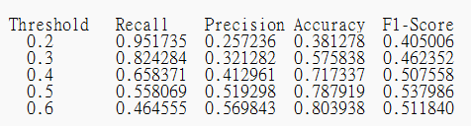
Threshold Sensitivity Analysis
Threshold affects Recall–Precision tradeoff
Lower thresholds increase Recall but reduce Precision
The model's task is to detect customers at risk of default (avoiding missed defaulters). We need high recall, but not unreasonably low precision. Therefore, threshold = 0.4 provides the most balanced result.

Slide 6
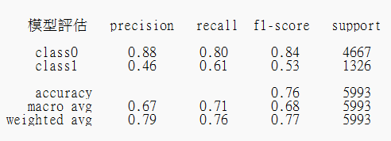
Model Evaluation
The model's overall accuracy is 0.76. The adjusted threshold is 0.44. However, due to data imbalance, the accuracy does not fully reflect the true performance.
It is necessary to observe the precision/recall performance of class1 (defaulters).
  Precision = 0.46 indicates that only 46% of those predicted to default actually default – a high false positive rate.
  Recall = 0.61: The model can detect approximately 61% of defaulters.
  F1-score = 0.53: Achieving a basic balance between precision and recall.

Slide 7
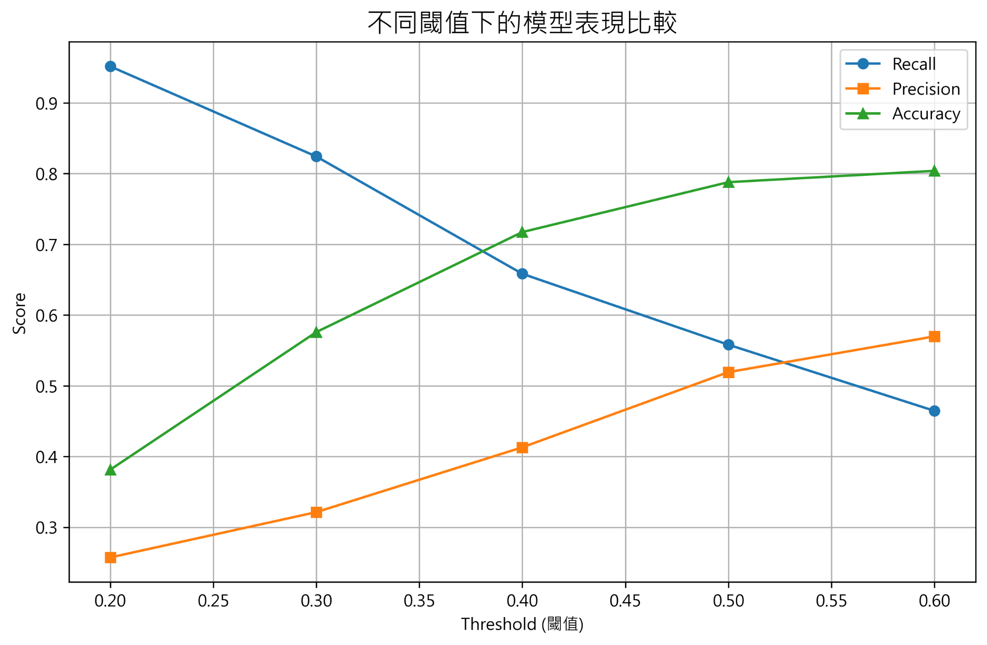
Model Performance at Different Thresholds

Slide 8
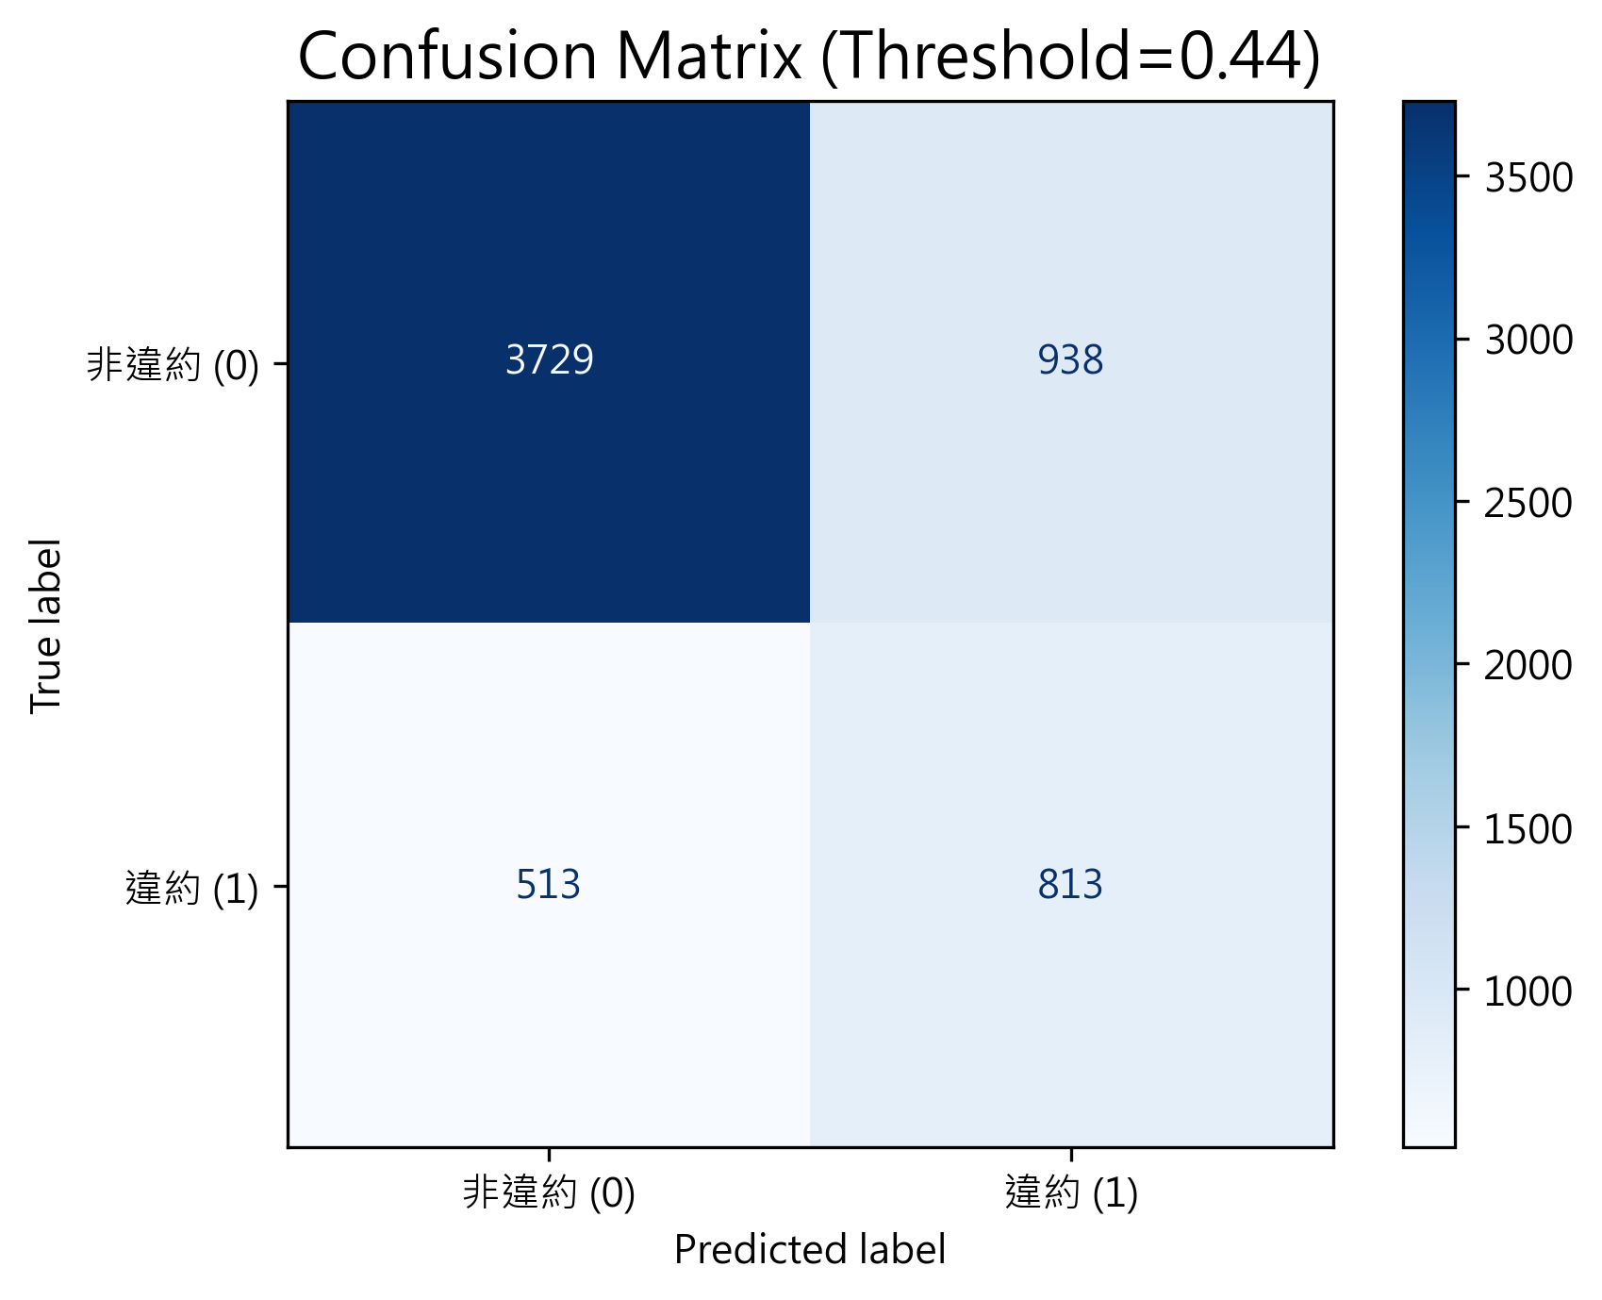
Confusion Matrix

Slide 9
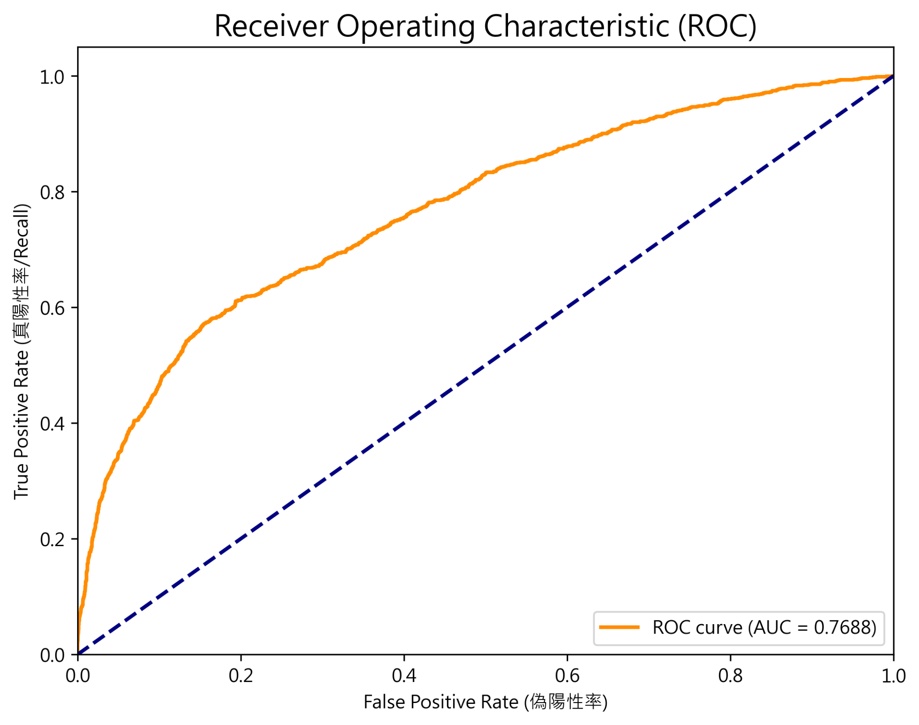
ROC Curve (AUC=0.7688)

Slide 10
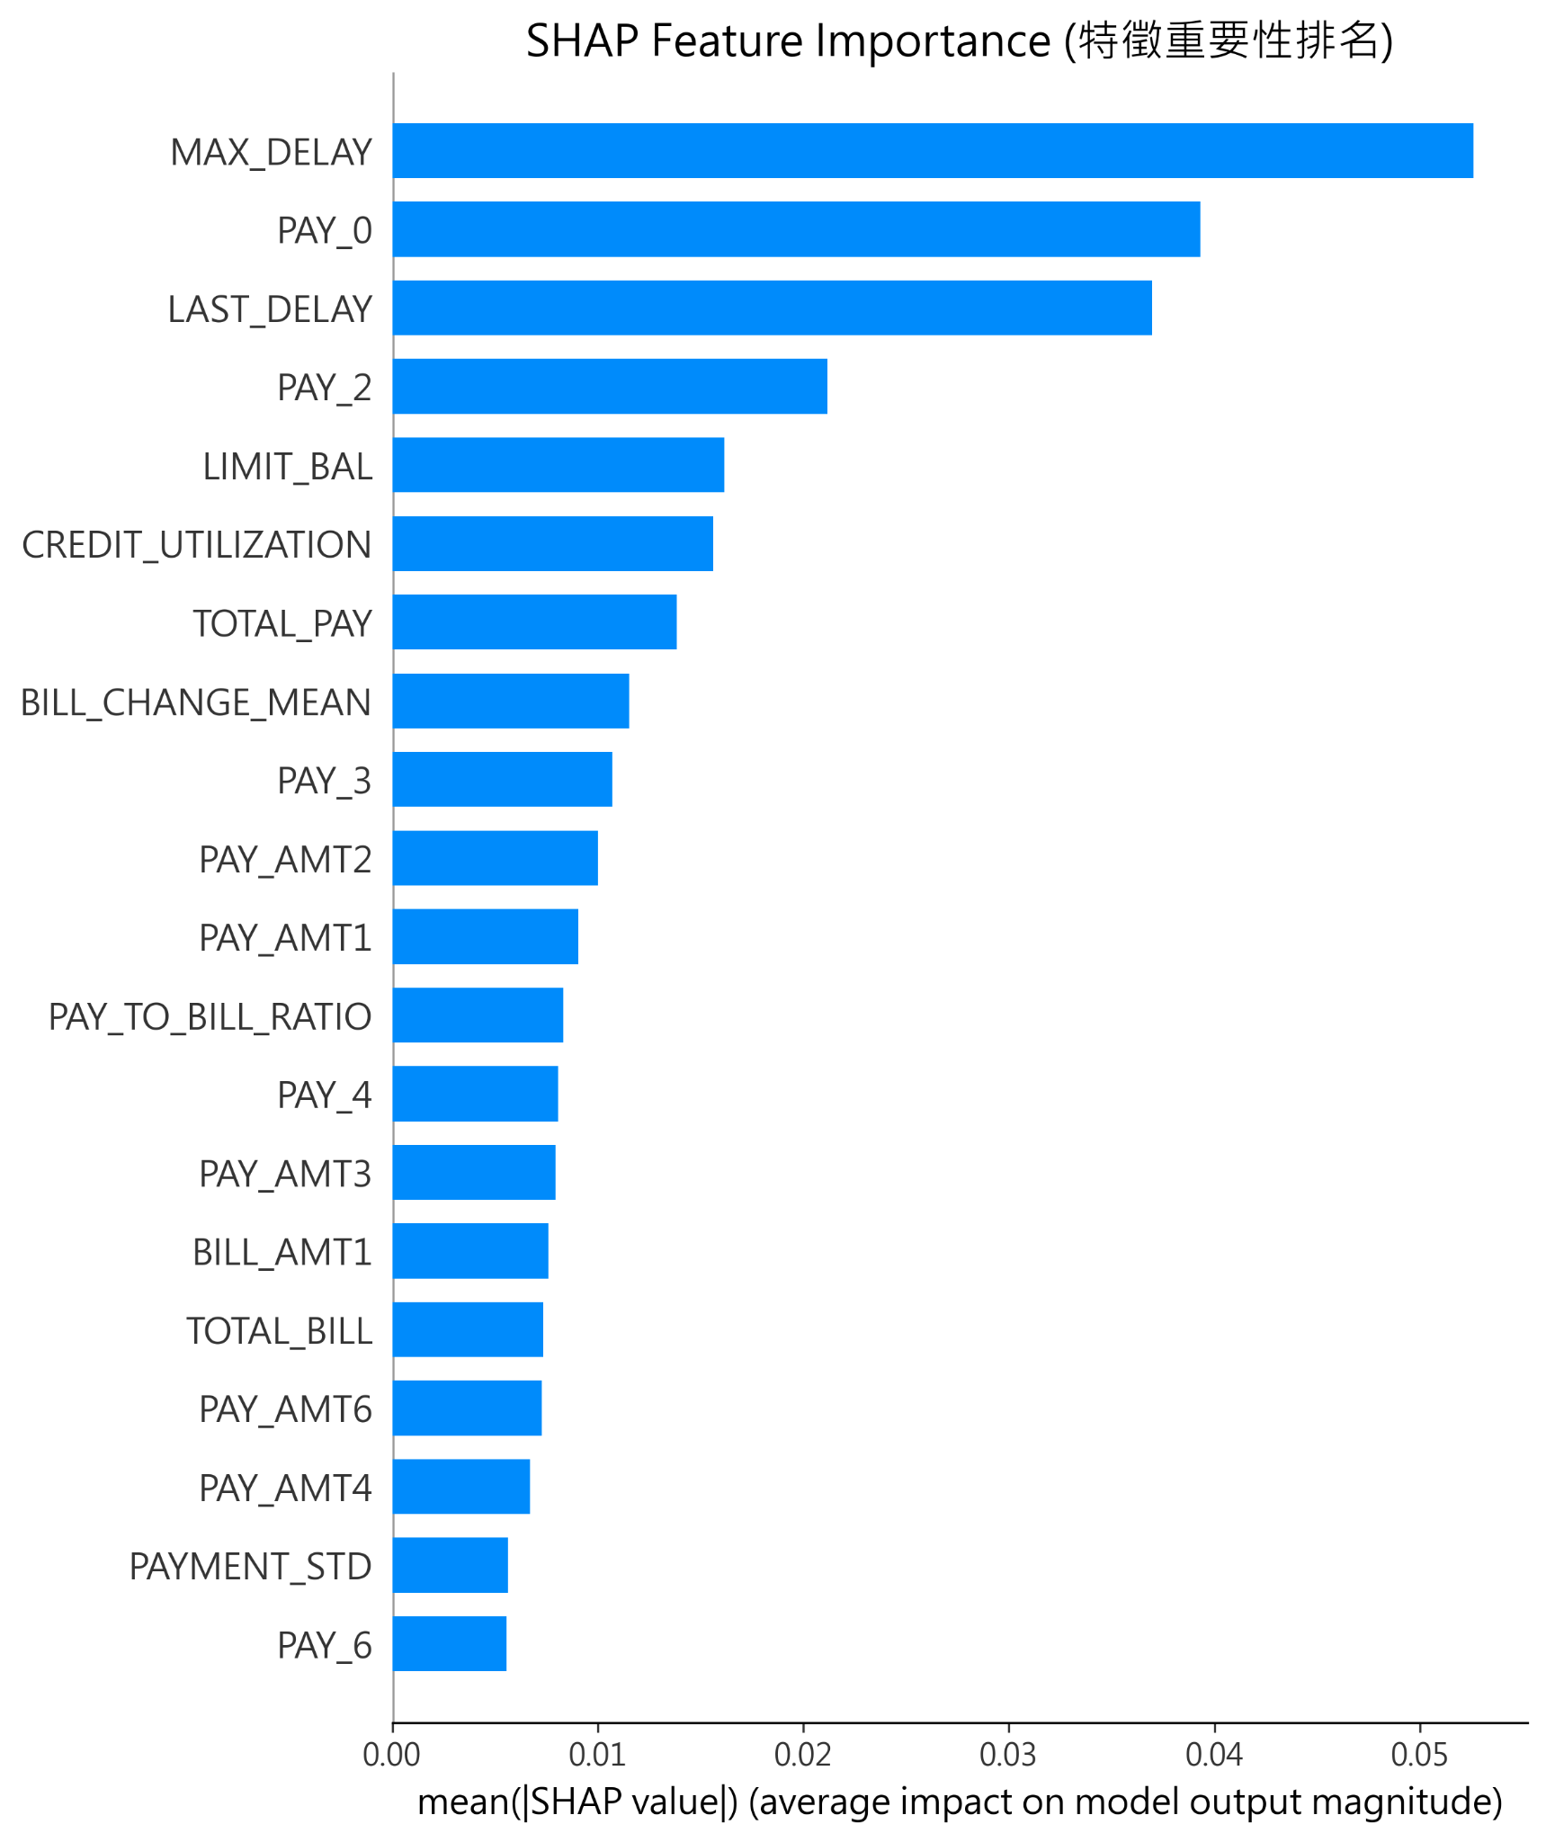
SHAP Feature Importance

Slide 11
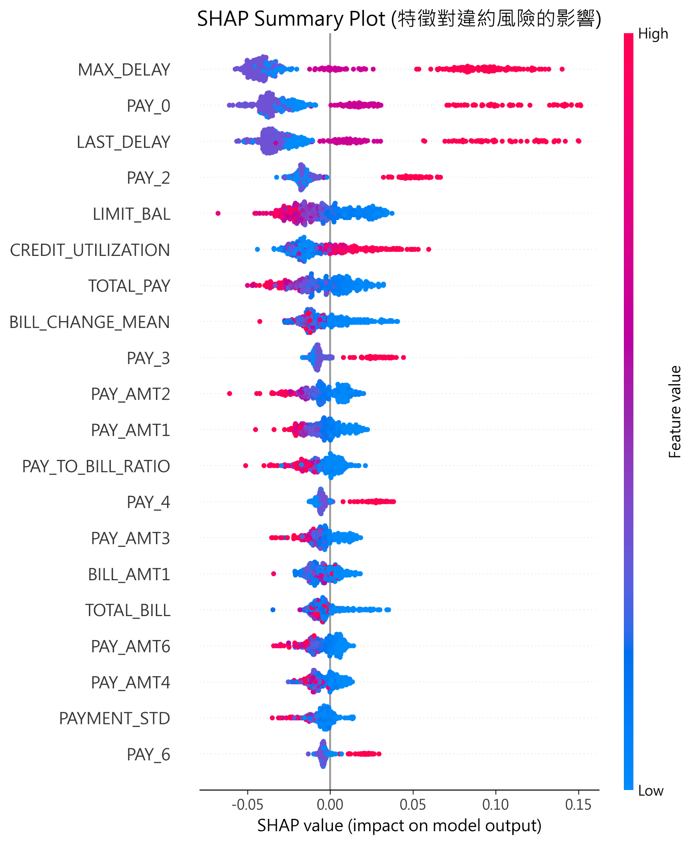
SHAP Summary Plot

